Slide 1

COST
Conditional Probability

Slide 2
Revision
Inclusion Exclusion Principle
Venn Diagrams
2 sets
3 sets

Slide 3
Conditional Probability
Suppose that we are interested in computing the probability of event A and we have been told event B has occurred.
Then the conditional probability of A given B is defined to be:

Slide 4
Conditional Probability
Event B has occurred then the sample space is restricted to B.
The event A can now only occur if the outcome is in A ∩ B. Hence the new probability of A is:
A
B
A ∩ B

Slide 5
Question
For a specific married couple, the probability that the husband watches the show is 80%, the probability that his wife watches the show is 65%, while the probability that they both watch the show is 60%.
What is the probability that wife is also watching the show if the husband is watching the show?

Slide 6
Solution:
Let A = the event that wife watches the show
P[A]= 0.65
Let B = the event that the husband watches the show
P[B]= 0.80
P[A ∩ B]= P(both watching the show) = 0.60

Slide 7
Question Nov 18
The data from a survey of 140 students showed that 37 study Music, 103 play a sport and 25 do neither. Create a Venn diagram to illustrate the data collected and then determine the probability that if a student is selected at random.
He or she will study music
b) He or she will study music given that he or she play sport
Solution-
Let set M- Students studying music
n(M) = 37
Set S- Students playing sports
n(S) = 103
Total Students N= 140
n(M U S) = 140 – 25 = 115

Slide 8
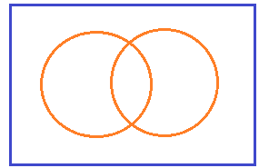
Cont..
140
Formula-
n (M ∪ S) = n(M) + n (S) - n (M ∩ S)
115 = 37 + 103 - n (M ∩ S)
n (M ∩ S) = 37 + 103 - 15
= 25
Students stydying only music= n(M)- n(M ∩ S)
= 37- 25
= 12
Students stydying only sports= n(S)- n(M ∩ S)
= 103 - 25
= 78
S
25
M
12
25
78
M ∩ S

Slide 9
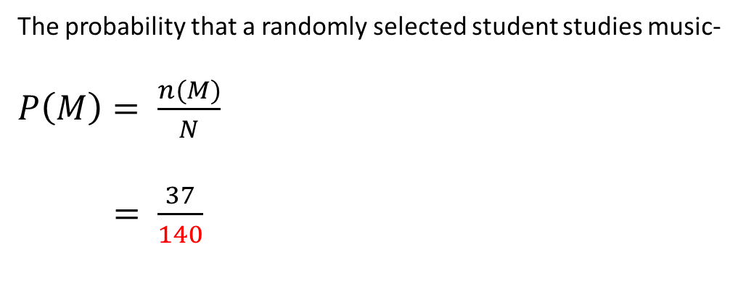
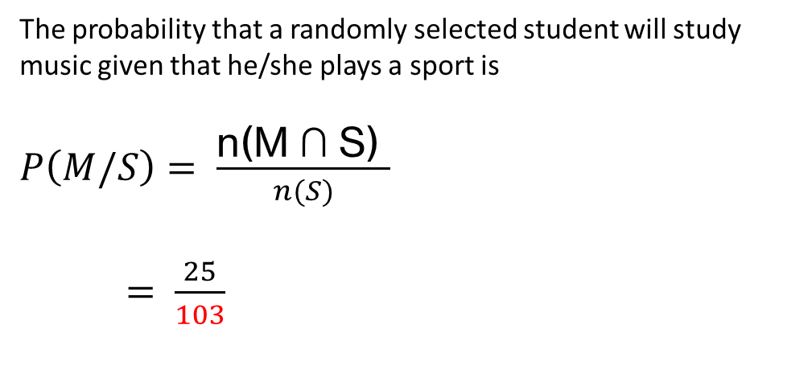
Cont..
140
The probability that a randomly selected student studies music-
$P\left(M\right)= \frac{n(M)}{N}$
$= \frac{37}{140}$
S
25
M
12
25
78
The probability that a randomly selected student will study music given that he/she plays a sport is
$P\left(M/S\right)= \frac{\text{n}\text{(}\text{M}\text{ ∩ }\text{S}\text{) }}{n(S)}$
$= \frac{25}{103}$
M ∩ S

Slide 10


Dependent Events
When two events are dependent events, one event influences the probability of another event.
A dependent event is an event that relies on another event to happen first.
Dependent

Slide 11


Independent Events
An independent event is an event that has no connection to another event’s chances of happening
In other words, the event has no effect on the probability of another event occurring.

Slide 12
Dependant and Independent events
Dependent
Independent
if A and B are independent.

Slide 13
Question April 18
One bag contains 4 white balls and 2 black balls; another contains 3 white balls and 5 black balls. If one ball is drawn from each bag, find the probability that (i) both are white, (ii) both are black, and (iii) one is white and one is black.
Solution -
Bag 1
Bag 2
W - 4
B - 2
W – 3
B - 5

Slide 14
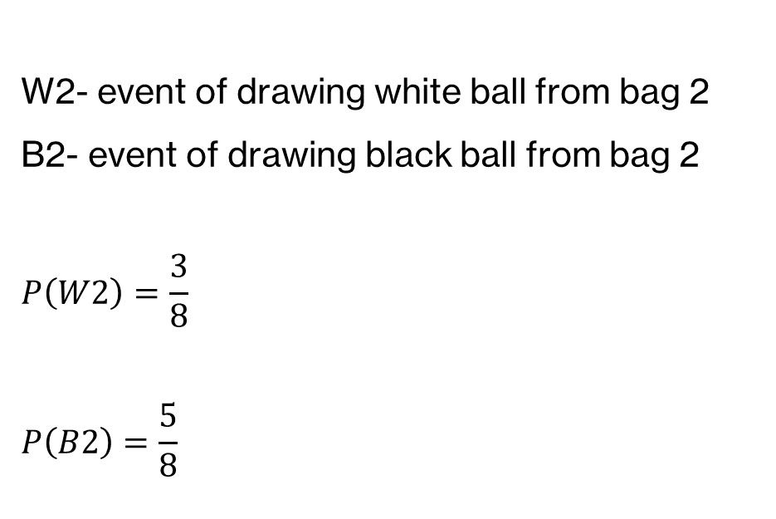
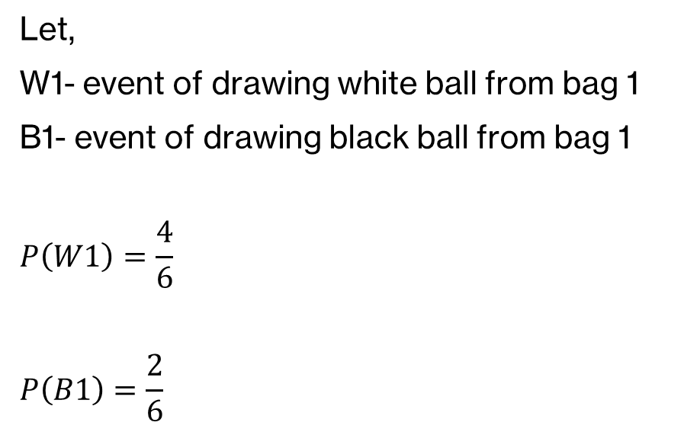
Cont..
Bag 1
Bag 2
W - 4
B - 2
W – 3
B - 5
Let,
W1- event of drawing white ball from bag 1
B1- event of drawing black ball from bag 1
$$P\left(W1\right)=\frac{4}{6}$$
$$P\left(B1\right)=\frac{2}{6}$$
W2- event of drawing white ball from bag 2
B2- event of drawing black ball from bag 2
$$P\left(W2\right)=\frac{3}{8}$$
$$P\left(B2\right)=\frac{5}{8}$$

Slide 15

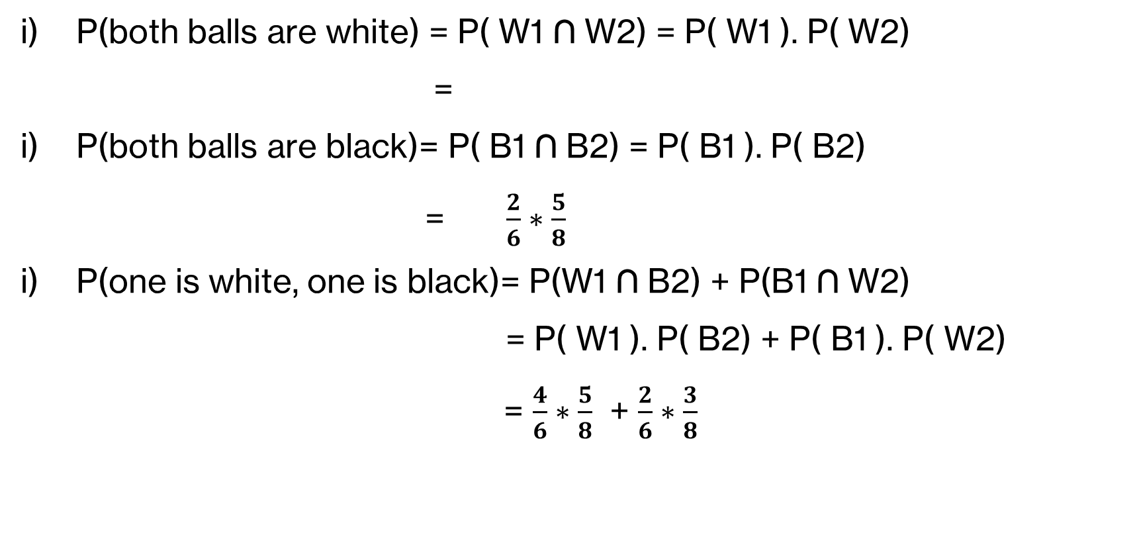
Cont..
P(both balls are white) = P( W1 ∩ W2) = P( W1 ). P( W2)
=
P(both balls are black)= P( B1 ∩ B2) = P( B1 ). P( B2)
= $\frac{2}{6}∗\frac{5}{8}$
P(one is white, one is black)= P(W1 ∩ B2) + P(B1 ∩ W2)
= P( W1 ). P( B2) + P( B1 ). P( W2)
= $\frac{4}{6}∗\frac{5}{8}$ + $\frac{2}{6}∗\frac{3}{8}$
$$\frac{4}{6}∗\frac{3}{8}$$

Slide 16
Question
Two shooters, Ravi and Suraj are firing a target. The probability the they hit the target are 1/3 and 1/2 respectively. If they fire independently, find the probability that-
Both hit the target
Nobody hits the target
At least one hit the target
Exactly one hits the target

Slide 17
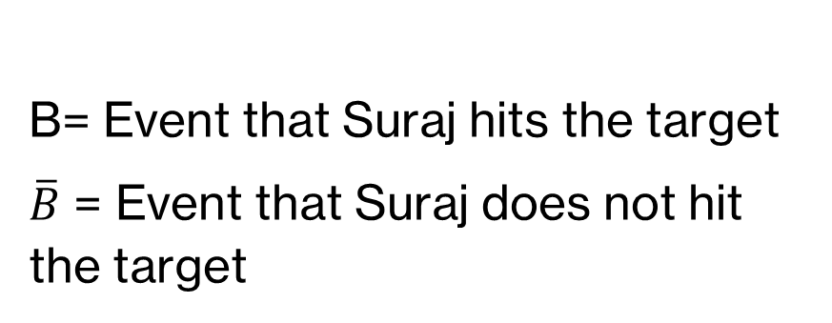
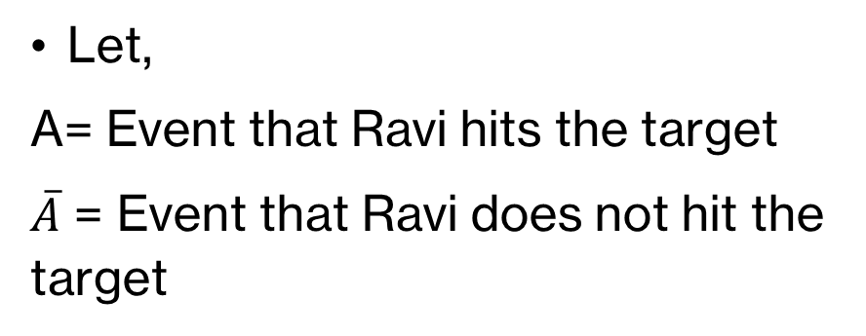
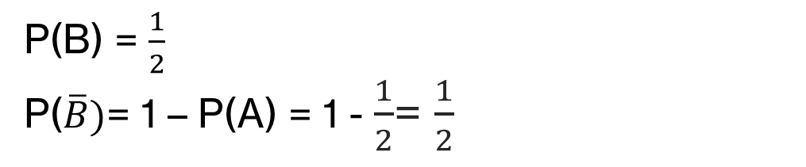
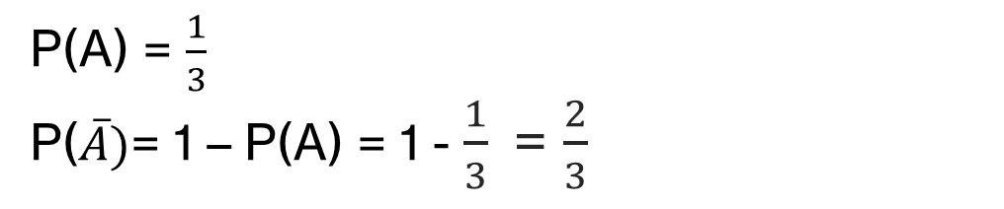
Solution
Let,
A= Event that Ravi hits the target
$\overline{A}$ = Event that Ravi does not hit the target
B= Event that Suraj hits the target
$\overline{B}$ = Event that Suraj does not hit the target
Two events A and B are independent.
P(A) = $\frac{1}{3}$
P($\overline{A})$= 1 – P(A) = 1 - $\frac{1}{3}$= $\frac{2}{3}$
P(B) = $\frac{1}{2}$
P($\overline{B})$= 1 – P(A) = 1 - $\frac{1}{2}$= $\frac{1}{2}$

Slide 18
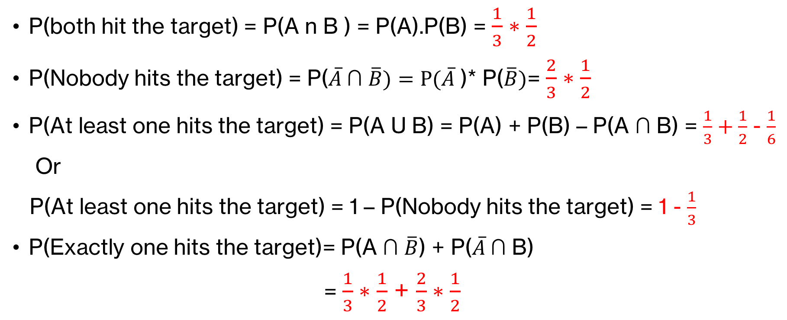
Cont..
P(both hit the target) = P(A n B ) = P(A).P(B) = $\frac{1}{3}∗\frac{1}{2}$
P(Nobody hits the target) = P($\overline{A} \text{∩} \overline{B})=P(\overline{A}$)* P($\overline{B})$= $\frac{2}{3}∗\frac{1}{2}$
P(At least one hits the target) = P(A U B) = P(A) + P(B) – P(A $\text{∩}$ B) = $\frac{1}{3}+\frac{1}{2}$ - $\frac{1}{6}$
Or
P(At least one hits the target) = 1 – P(Nobody hits the target) = 1 - $\frac{1}{3}$
P(Exactly one hits the target)= P(A $\text{∩} \overline{B}$) + P($\overline{A} \text{∩}$B)
= $\frac{1}{3}∗\frac{1}{2}$ + $\frac{2}{3}∗\frac{1}{2}$

Slide 19
Question
A box contains 6 white and 4 black balls. 2 balls are selected at random from the box one after another. Find the probability that both balls are white if the balls are selected
Without replacement
With replacement

